Slide 1
Society of Women Engineers
Membership Benefits
membership.swe.org

Slide 2
Collegiate to Career (C2C) Membership
Ease the transition from college to career.
One-time $50 payment
SWE Membership for entire collegiate career + first year of professional career
C2C Membership is beneficial for collegiate members with two or more years of schooling left.
Already a C2C member?
Make sure your education information is always current in your SWE membership profile! This membership relies on the graduation date listed in your profile - it must be in the future for the C2C membership to remain active.

Slide 3
A Global Community
The SWE community is 40,000+ strong and members come from all walks of life.
Take advantage of all the member benefits SWE has to offer:
Scholarships
Industry Content in SWE Magazine,
All Together and SWE’s podcast, Diverse
Career Center
Awards and Recognition Programs
Education & Professional Development
Affinity Groups
Global & Local Events
Leadership Development

Slide 4
SWE Scholarships
SWE Scholarships provide funding and support to women pursuing engineering.
200+
SCHOLARSHIPS
and $830,000+ dispersed in 2018.
VISIT SCHOLARSHIPS.SWE.ORG TO:
1
Find out if you’re eligible for a SWE scholarship
3
Get notified when applications open
2
View available scholarships
4
Learn how to apply for a SWE scholarship
When are scholarship applications open?
Sophomore through Graduate: December 1 - February 15
Incoming Freshman: March 1 - May 1

Slide 5
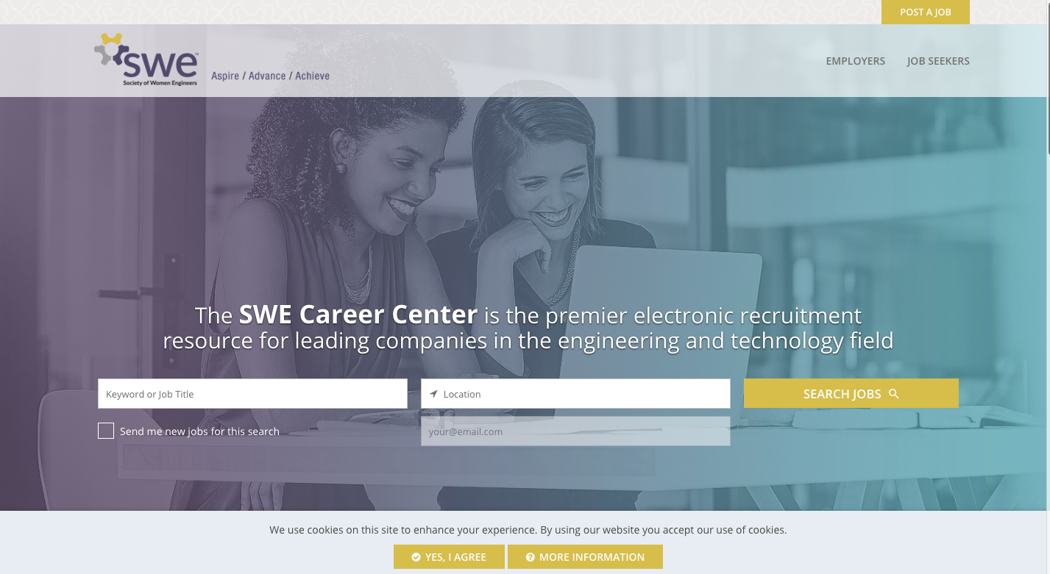
Career Center
Find your next career opportunity at SWE’s Career Center.
Hundreds of job openings posted each month from some of the largest engineering and technology organizations across the globe. Both internships and full-time employment opportunities are featured.
Browse job openings by engineering discipline, country, state and job function.
careers.swe.org

Slide 6
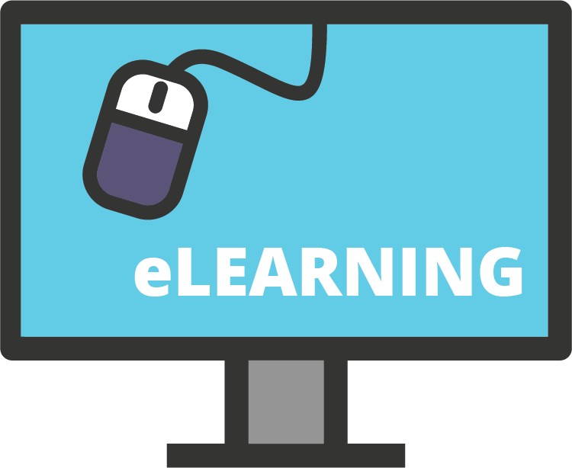
Education & Professional Development
Access hundreds of webinars and e-Learning courses to help you prepare for your first interview, negotiate your first salary, and more!
Live Webinars
Interact in real-time with subject matter experts
On-Demand Webinars
Access previously recorded content
e-Learning Courses Interactive online learning
Text SWE Advance to 56512 to receive Advance alerts.
#SWEAdvance | advancelearning.swe.org

Slide 7
Global & Local Events
SWE members attend SWE conferences and events to connect with friends, explore the next step in their careers, and advance personally and professionally.
The largest conference and career fair for women in engineering.
More than 300 engineering and technology organizations recruiting for jobs onsite at the Career Fair.
we19.swe.org
Meet Locally. Learn Socially. at WE Local, a localized version of the SWE Annual Conference.
welocal.swe.org

Slide 8
Section Events
Use this slide to feature information about past or future section events to give members an idea of how they can get more involved.

Slide 9
Award-Winning Content
SWE Magazine
Official publication of SWE
Covers the engineering industry and topics of importance to women engineers
Mailed out quarterly and also available online at alltogether.swe.org
All Together
SWE’s digital news platform
Read stories about women in engineering and Society news
Contribute an article - a great resume builder!
alltogether.swe.org
Diverse Podcasts
SWE’s podcast channel
Interviews with influential women in engineering
soundcloud.com/swepodcasts
Follow SWE on social media!
Facebook: @SWEorg
Twitter: @SWEtalk
LinkedIn: @Society of Women Engineers
Instagram: @SWEtalk
Snapchat: SWEorg
Research
Features industry data and original SWE research
research.swe.org

Slide 10
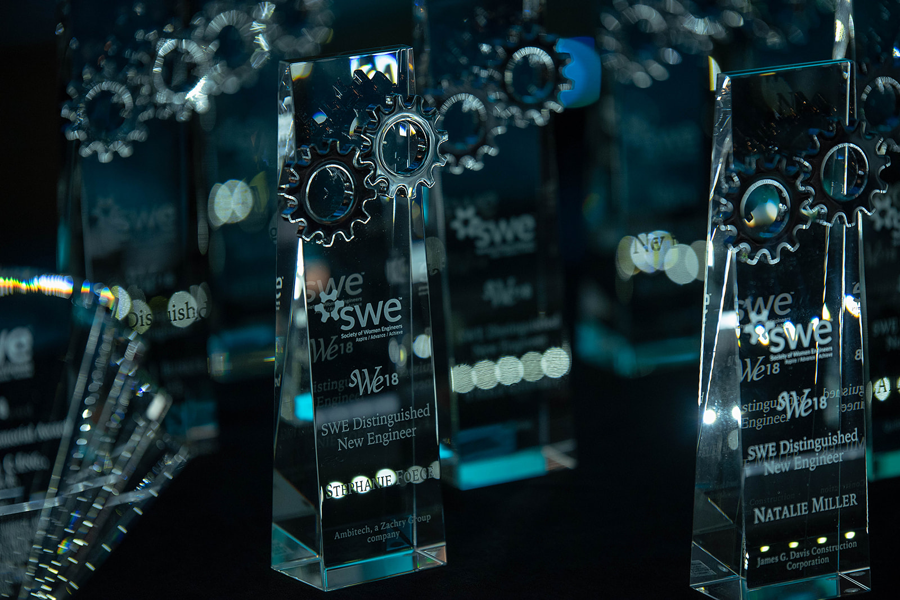
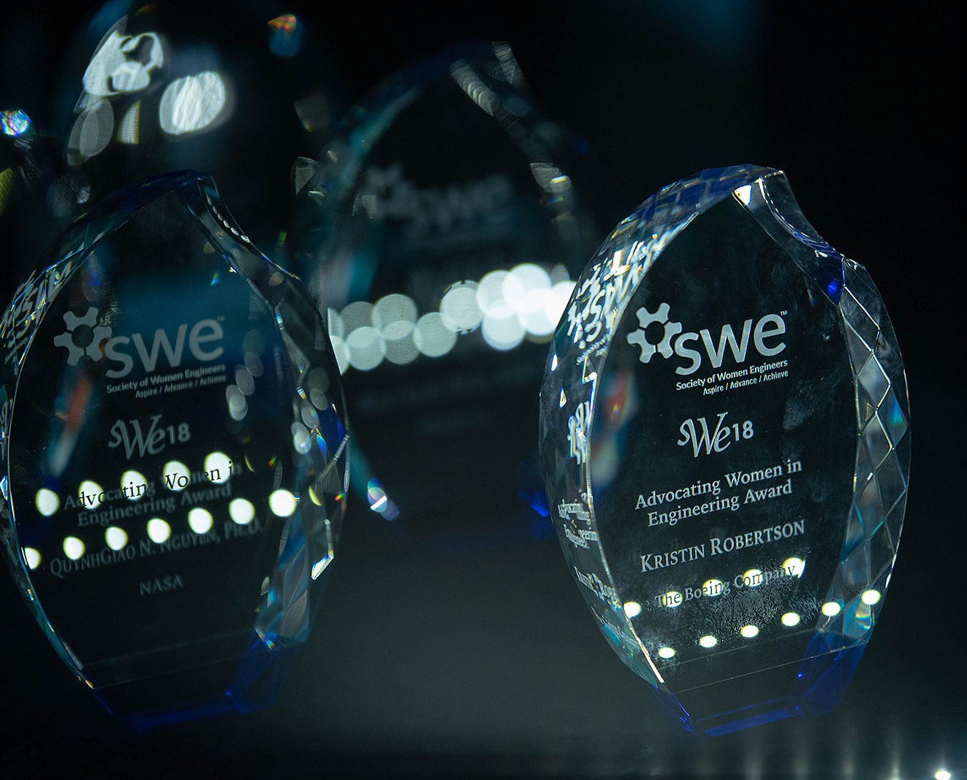
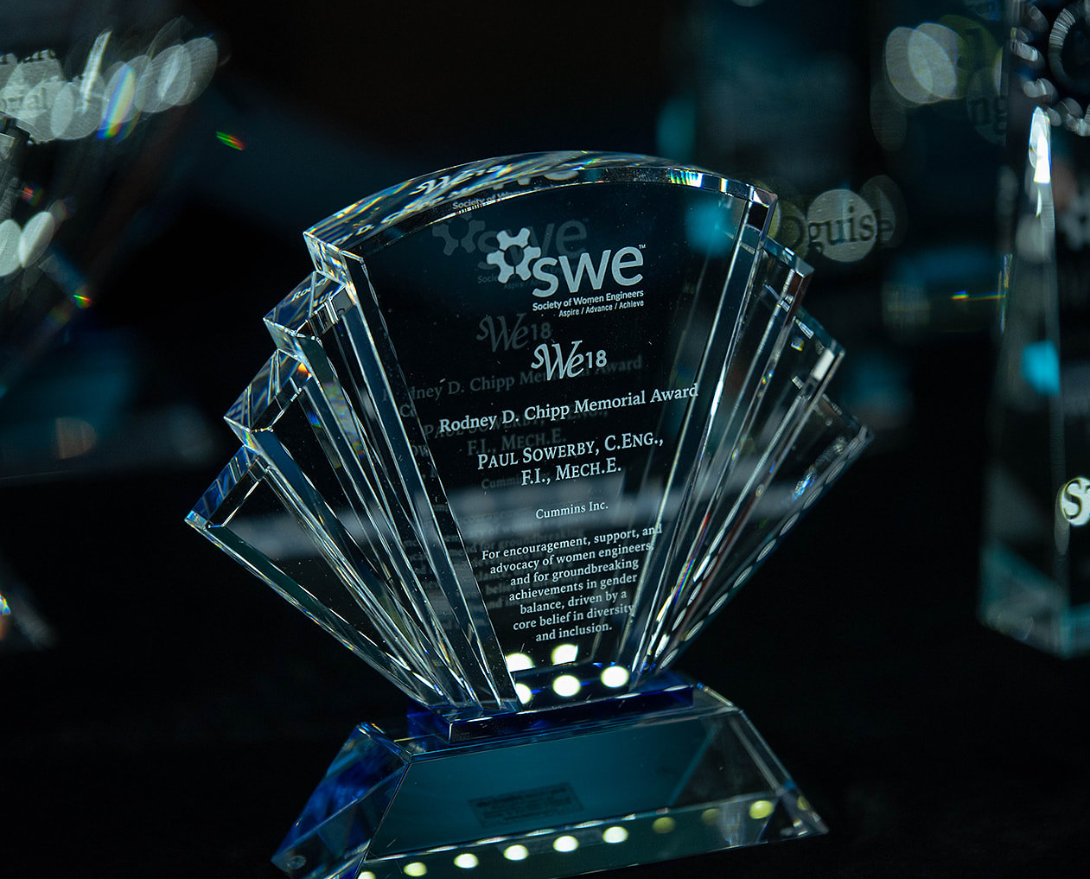
Awards & Recognition Programs
The Society of Women Engineers strives to advance and honor the contributions of women at all stages of their careers as well as recognize the successes of SWE members and individuals who enhance the engineering profession through contributions to industry, education and the community.
SWE Awards are an excellent resume builder - consider nominating someone for the Outstanding Collegiate Member Award.
Learn more at awards.swe.org

Slide 11
Diversity & Inclusion: SWE Affinity Groups
SWE’s Affinity Groups are small communities within the organization where individuals share a common element of diversity and work collaboratively together to celebrate peers from different paths of life.
African Americans
Global Women Engineers
Latinos
Small Business Women Engineers
Native Americans
Women in Government
LGBTQ & Allies
Entrepreneurs
Learn more about each group and request to join a group you identify with here.

Slide 12
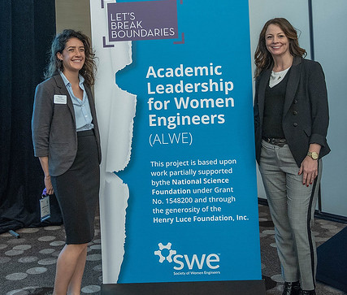
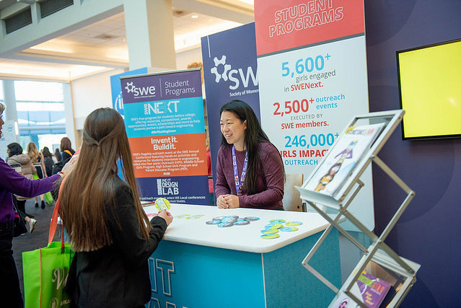
Leadership Development
Get involved in your SWE section!
Join the leadership team or volunteer for special events.
The skills you learn will help you emerge as a leader in your engineering career.

Slide 13
We hope you find all of SWE’s membership benefits useful and join or renew your membership today! If you have any questions about SWE’s member benefits, please do not hesitate to reach out to membership@swe.org.

Slide 14
Continue your Journey with SWE.
Join or Renew today.
membership.swe.org

