Slide 1
Add these slide to your presentation when introducing SWENext to a general audience (students, parents or educators)

Slide 2
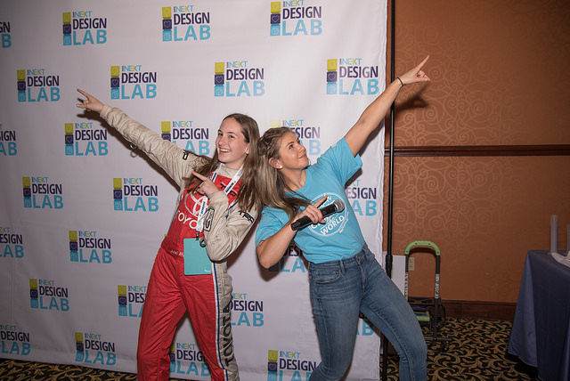
What is SWENext?
Program for pre-college aged students who want to be a part of SWE.
The cost to join is free.
Who can join SWENext?
Students ages 13-18 can join anytime.
Students under 13 require a parent or guardian’s contact to join.
Families, educators, and SWE members can join the SWENext mailing list to get more information.

Slide 3
Benefits of SWENext
Scholarship information
Awards
At-home engineering activities
SWENext Club resources
Mentoring
Events
Cool projects
Contests
SWE goodies
Join SWENext at swenext.swe.org

