Slide 1
Treasure Roles and Responsibilities
Society Finance Committee

Slide 2
Objectives
The Participant will be able to:
Understand their roll as a treasurer.
Learn typical responsibilities of section treasurers.
Create a basic timeline of tasks they need to complete during the year.
Be prepared to have a good transition at the start and end of their term.

Slide 3
Table of Contents
Treasurer Responsibilities
Timelines and Dates
Treasurer Documentation
Direct Deposit Sign-Up
End of Year Transitions
Finance Resources

Slide 4
Treasurer Responsibilities

Slide 5
Treasurer Responsibilities
Work as a part of your section’s executive leadership to ensure financial assets are tracked and protected
Essential Activities
  Responsible for tracking and protecting all section assets
  Collect, safely keep, and distribute funds
  Sign checks / Deposit funds
  Keep an exact accounting of all receipts and expenditures
  Prepare and submit the annual section budget
  Ensure Sections IRS filings are complete (EIN up to date)
  Maintain updated signature cards for all bank accounts
  Safeguard all financial documents
  Maintain all passwords for online banking activity

Slide 6
Treasurer Responsibilities (2)
Additional activities depending on the size or goals of the section:
  Chair or oversee the section finance committee
  Oversee all fundraising activities for the section
  Present financial reports at executive council meetings
  Supervise/maintain all online payment processes (PayPal, Square, Eventbrite, etc.)

Slide 7
A year in the life of a Treasurer

Slide 8
Required Paperwork (EVERY YEAR)
Professional Sections
  File your section’s e-postcard or 990 tax forms
    Due November 15th
  Prepare and submit the annual financial report to the Society
    Due July 30th
Collegiate Sections
  Are you covered under your university’s EIN?
    Yes: Do not file tax forms or apply for an EIN
    No: File your section’s e-postcard or 990 tax form Due November 15th
  Prepare and submit the annual financial report to the Society
    Due July 30th
Section Reports must be submitted to receive your rebates!!

Slide 9
Recommended Activity Timeline
Monthly | Review/Approve/Disburse funds for Reimbursement Requests/Checks Review financial statements/trends with Executive Council/Officers
July | Transition with Previous Treasurer and Complete Annual Financial Report Transfer accounts to incoming President/Treasurer
July-Aug | Solicit Officer and Committee Chair Input to Prepare/Approve Annual Budget
Aug-Sept | Review/Approve Section Finance Policy Review/Approve Section Travel Grant Policy (if needed) Submit IRS Filing (if applicable)
Sept-Oct | At least one month before the SWE Annual conference or other eligible events, announce travel grant recipients
Oct | Attend SWE Annual Conference
Jan-Feb | At least one month before SWE WELocal conference announce travel grant recipients
Apr-May | Solicit incoming officers for input to next years budget as they transition
May-June | Set final reimbursement request date and disburse final checks

Slide 10
Section Specific Activities Timeline
Treasurers should add section specific activities to their timelines. These could include:
Annual bills that need to be paid (PO Box, Constant Contact, etc.)
Major yearly events (Awards Banquet, Professional Development Event)
Scholarship Deadlines/Activities
Include this Timeline in the Transition Documentation!!

Slide 11
A Note About Federal Taxes and the IRS
Some collegiate sections may be covered by their school or university, and not require an individual EIN
  Check with your school/university first BEFORE applying for an EIN
All other sections are covered by SWE 501(c)3 status
  If you are not sure of your status, first email finance committee at finance-chair@swe.org
SWE HQ does not complete this filing on the section’s behalf: it is the responsibility of YOU, the TREASURER, to file each year
  The section risks losing the tax-exempt status if not filed every year!
Lost your EIN? Unsure of your Filing Status?
  Current fiscal year section Presidents and Treasurers are able to access EIN and subordinate status information through the SWE Leadership Portal. Directions on how to access that information can be found here: https://support.swe.org/support/solutions/articles/35000109178-faq-eins-the-irs-and-your-section
  Latest filing status with the IRS can be found here: https://apps.irs.gov/app/eos/
      You will need your section’s EIN or location (by mailing address) to search the database.

Slide 12
Required Documentation

Slide 13
Treasurer Documentation
As Treasurer, the following is REQUIRED to be kept on file and transitioned to the new Treasurer:
  Copies of 2 annual financial reports filed with the Society
  Section/MAL/Region EIN and copy of last year’s tax forms
    OR letter from appropriate official that you are covered by your school
  Full list of all financial institution(s) name, local branches, address, account numbers, and online access information
  Copy of last year’s budget and this year’s approved budget
  Current year’s ledger
  Check books and registers
  Any tax-exempt paperwork
  Full contact information for authorized check signers (copy of most current signature cards)
  Account numbers, login, and passwords for all online payment accounts (PayPal, Square, etc.)
  History of fundraising activities and fundraising inventory
  Section reimbursement policy/forms

Slide 14
Treasurer Documentation (2)
Recommended records and documentation to keep on file include:
  All financial updates for executive council from previous year
  Motions relating to financial changes from the approved budget
  Internal Assessment Forms (completed once a year)
  Reimbursement documentation and copies of invoices/receipts (Used in an internal assessment)
  A list of important dates and timelines for recurring events, reports, deadlines, etc.

Slide 15
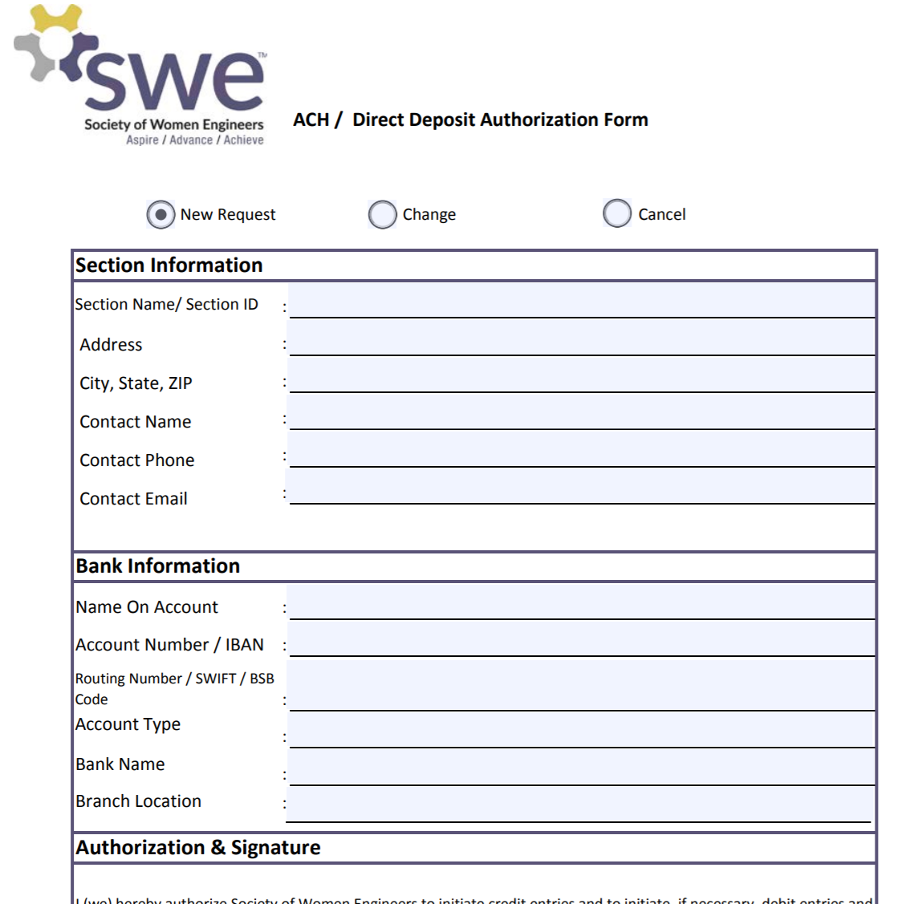
Direct Deposit for Section Rebates
Direct Deposit is now run through Concur as of FY18.
Direct Deposit form can be found under “Finance Templates and Forms” on the Finance Committee web page at swe.org.
Submit completed form to:
accounts.payable@swe.org

Slide 16
Year End Activities

Slide 17
End of Year Transitions (1)
The objective of transitions are to ensure the incoming treasurers have all the information necessary to successfully support the section.
Goals:
    Incoming treasurer is aware of all the section specific treasurer obligations
    New treasurer has timeline of actions required by IRS and SWE requirements
    All financial information is handed over and understood
    Financial account ownership is transferred
    Understand how your section budgets
    Understand how to reimburse members
    Understand how to pay/send invoices
    Know where your section keeps records

Slide 18
End of Year Transitions (2)
The outgoing treasurer should:
  Hand over a binder and/or digital copy of ALL financial resources
  Direct new Treasurer to location of current SWE financial resources
  Ensure new treasurer has access to financial records/institutions online by getting the signature authority transferred at the banking institution
  File Annual Report in July with the new Treasurer
  Review previous budget and how bills/reimbursements are completed
  Provide key dates by which IRS and SWE actions are required
The incoming treasurer should:
  Ensure you are not missing any financial documents
  Check that you have access to all online accounts, then update all online-account passwords, and record these new passwords
  Remove old officers from online financial access
  Determine with executive committee the frequency and details for reporting on financial health of section
  Ensure key dates on actions for IRS and SWE are in your calendar
  ** Your section may also have to transition checks, debit cards, etc. **

Slide 19
Example Forms

Slide 20
Budget Template
The first sheet available in the template should be used to “build” your budget based off of the previous year’s actual spending.
Comparing budgeted amounts to actuals allows you to have a better financial understanding for your SWE group
This template can be found under “Finance Templates” on the Finance Committee web page at swe.org.

Slide 21
Budget / Actuals
While a budget is important, understanding current spending is even more important.
“Actuals” are the amount received or spent year-to-date that can be compared with the budgeted amount.
If your actuals and budget are not similar at the end of year, update the budget for next year.
This template can be found under “Finance Templates” on the Finance Committee web page at swe.org.

Slide 22
Account Ledger
This template can be found under “Finance Templates” on the Finance Committee web page at swe.org.
There are drop-down category options built-in
The current template has built-in formulas that will auto-fill your ‘actuals’ column based on the category assigned to each transaction. Break up transactions into individual categories per line for accurate record keeping.
This column is used to reconcile when checks have cleared and match the bank statements

Slide 23

Financial Report Forms - Invoice
Notes:
SWE-CRS Example

Slide 24
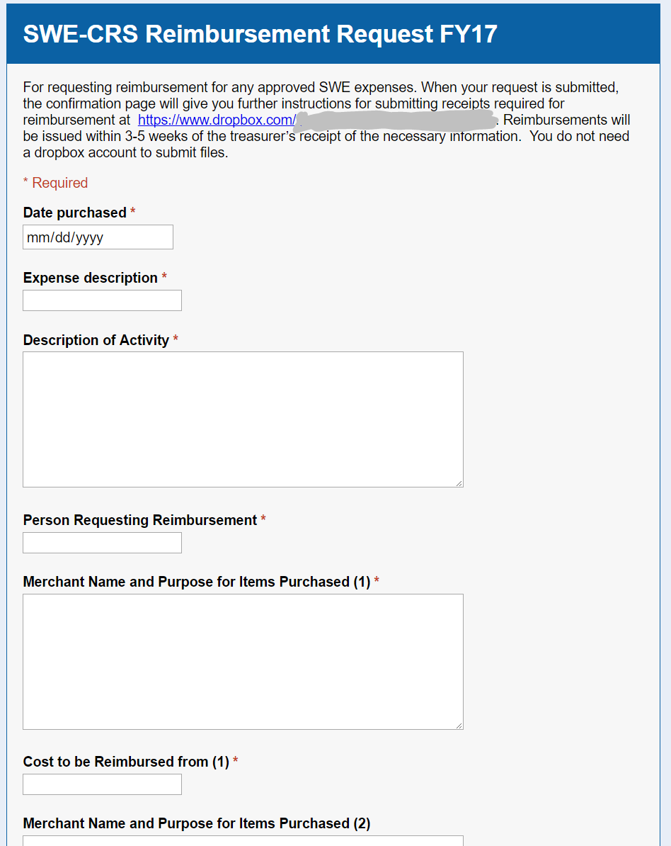
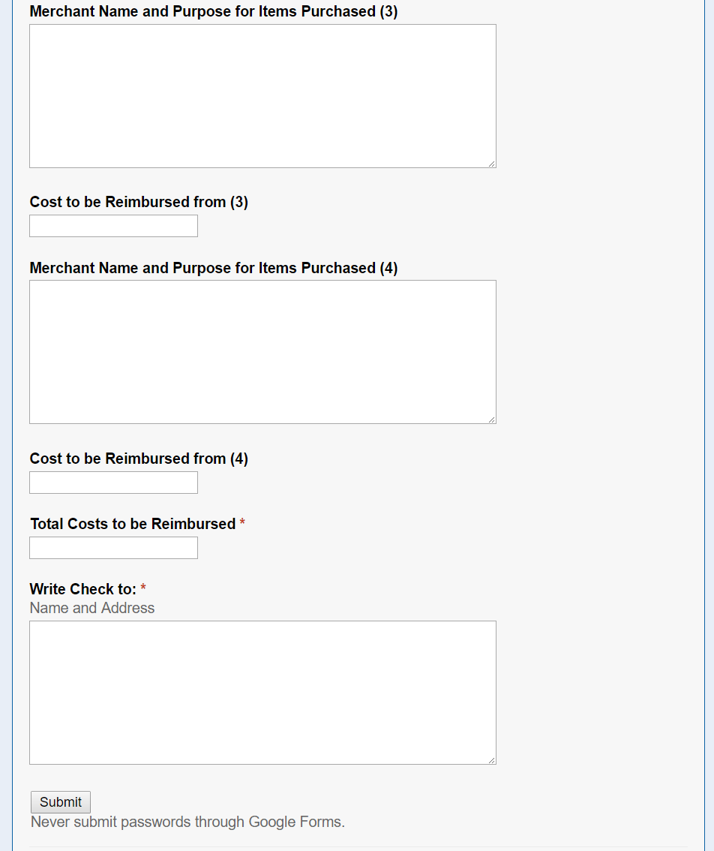
Financial Report Forms - Reimbursements
You can utilize online forms to send reimbursement requests directly to a spreadsheet for easy tracking and record keeping.
In this example, upon submittal of the form, the requestor is given a link to upload receipts directly to a SWE Section Dropbox.
Notes:
You can utilize online forms to send reimbursement requests directly to a spreadsheet for easy tracking and record keeping.

Slide 25
Financial Report Forms – Monthly Report
Charts and graphs to show trends are also helpful
Notes:
SWE-WI treasurer’s report to EC, monthly

